Slide 1
Voice Based
Library Management System
DBMS Mini Project Presentation
Presented by
Raghavendra K M | 1BY18IS093
Sanjana Gajanana Shetty | 1BY18IS104
Under the guidance of
Mrs. Drakshaveni G
Asst. Prof , Dept of MCA, BMSIT&M

Slide 2

Contents
Introduction
ERD
Schema
Tools used
Description
Screenshot
Execution
Conclusion

Slide 3
Introduction
A Voice Based Library Management System is a software that has been developed to handle basic housekeeping functions of a library.
It’s well organized software solution for a Library Management System.
It helps to provide information on any book present in library to the user as well as for staff.
It keeps a track of borrowed, returned and added books to the library.

Slide 4
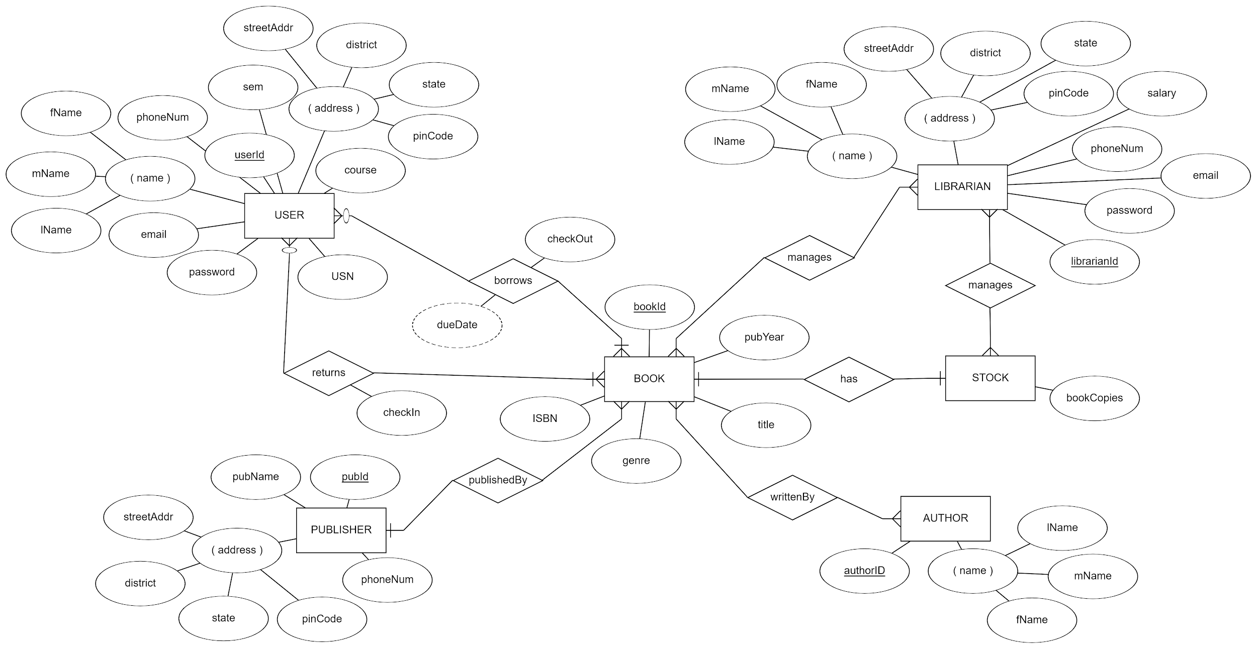
Entity Relationship Diagram :

Slide 5
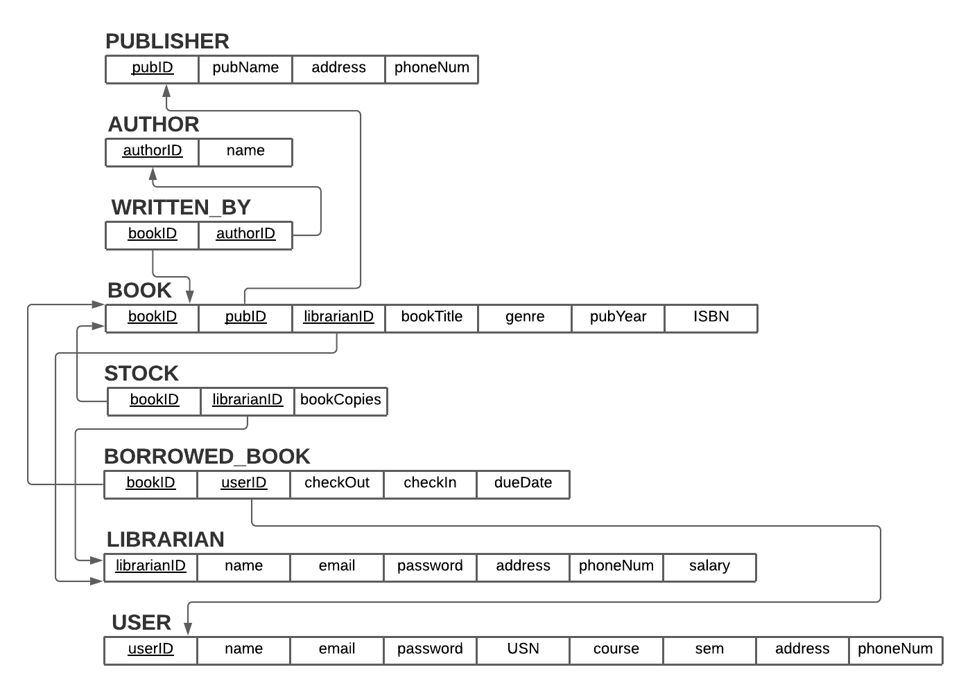
Schema Diagram :

Slide 6








Tools used

Slide 7




Main characters in the project
Student
Staff
Admin
He can borrow and return the books from the library
She can insert, update and delete books in the library
He is having privileges to add, update delete Staffs. And also he can do CRUD for all the tables in the database

Slide 8
Description
Signin and Signup facility for all - Librarian(staff), User(student) and Admin
Solid authentication methods for both staff and student
A voice-based search system which can help students as well as faculty in searching books.
Student can borrow and return books from library.
Staff can insert, update, delete records from Authors, Publishers and Books
Staff can view the no. of books borrowed and returned.
Admin can perform CRUD along with that, he can also restrict Staff registration(to prevent fake staff login)
Sorting and searching of books based on different parameters(title, author, publisher, etc)

Slide 9
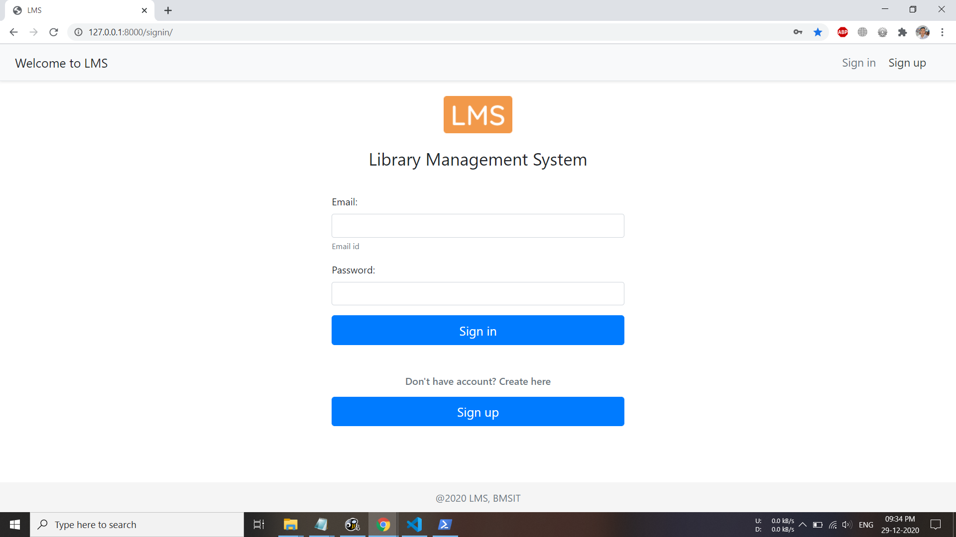
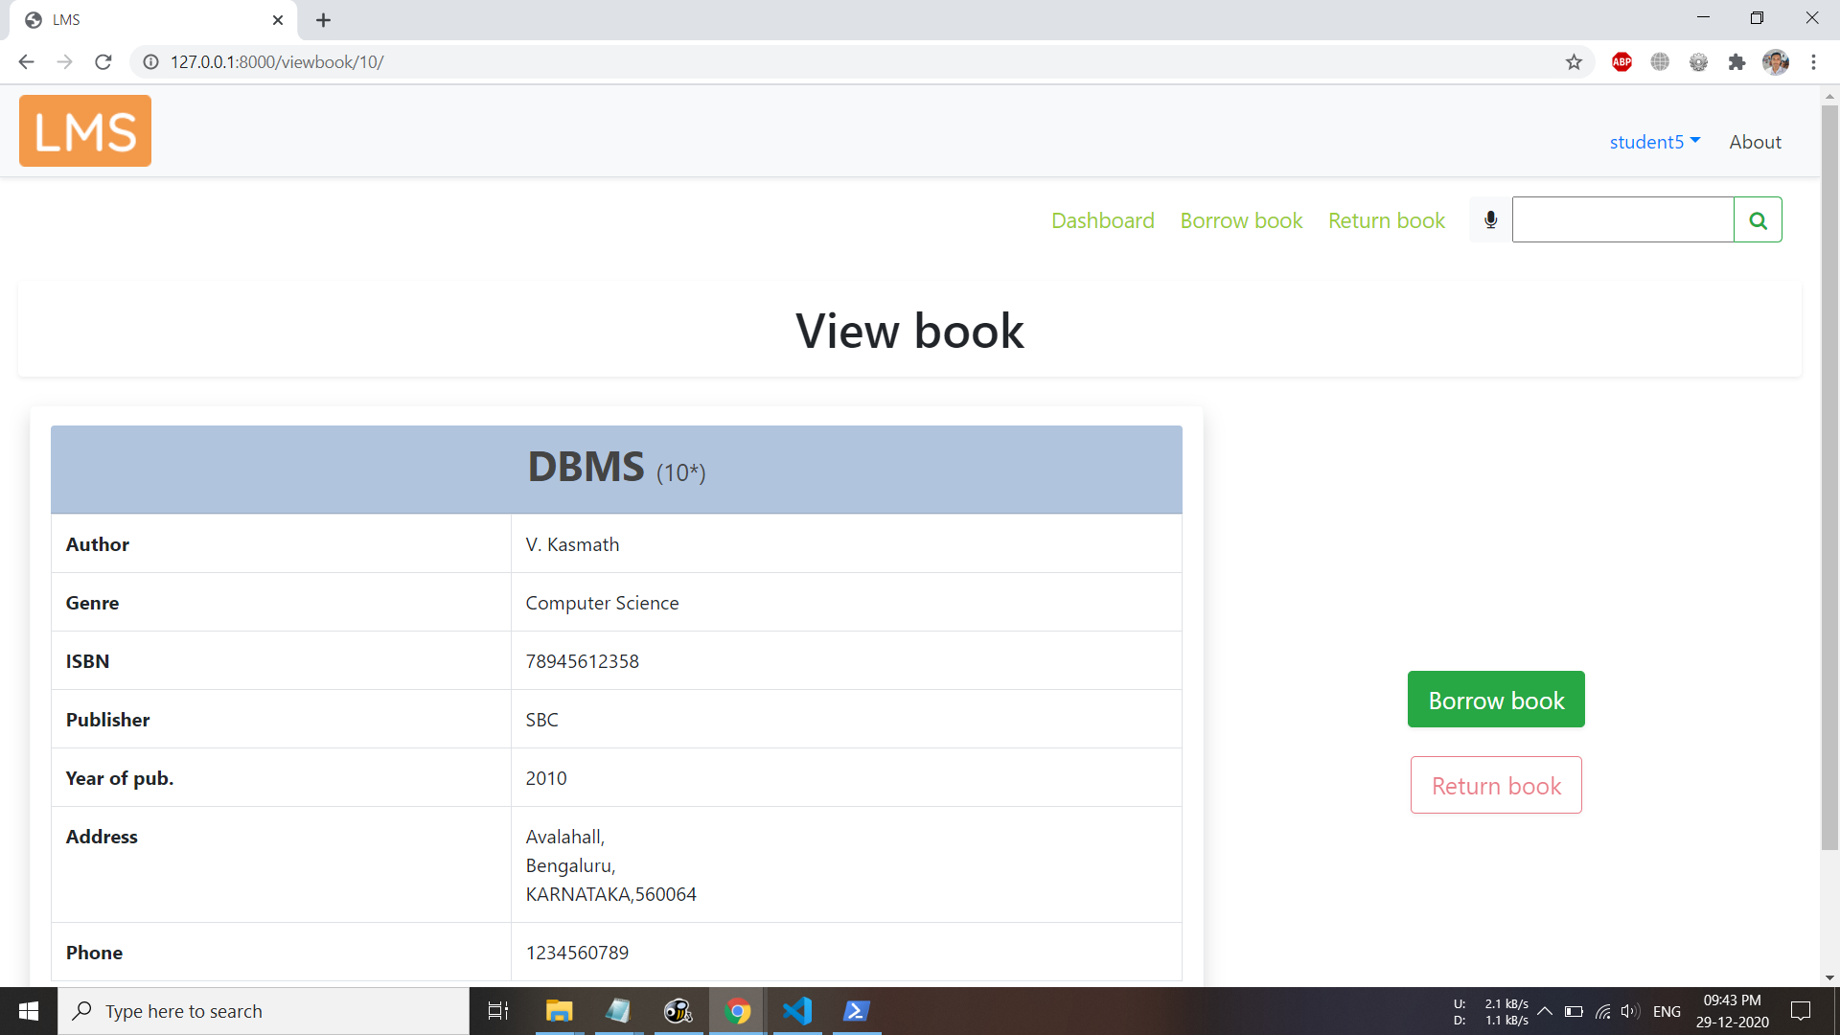
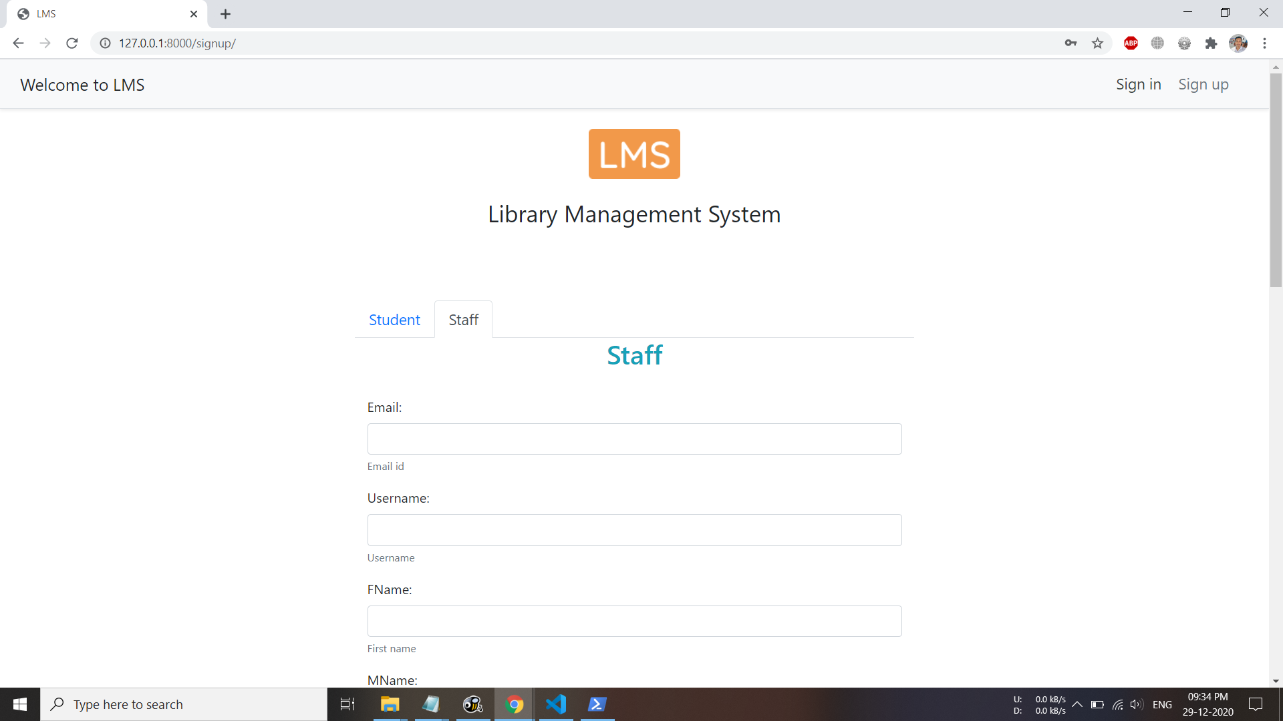
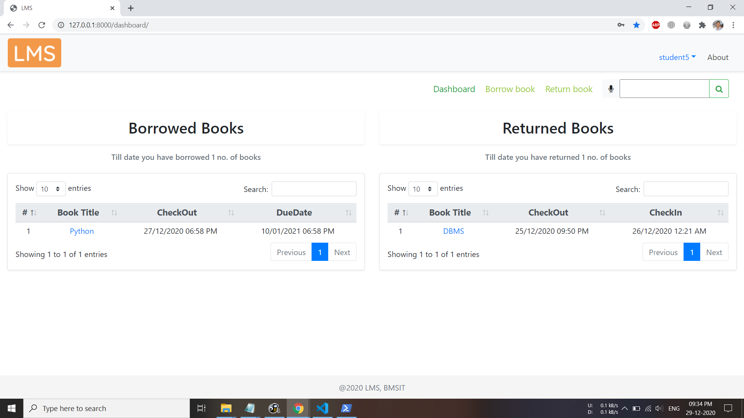

Slide 10
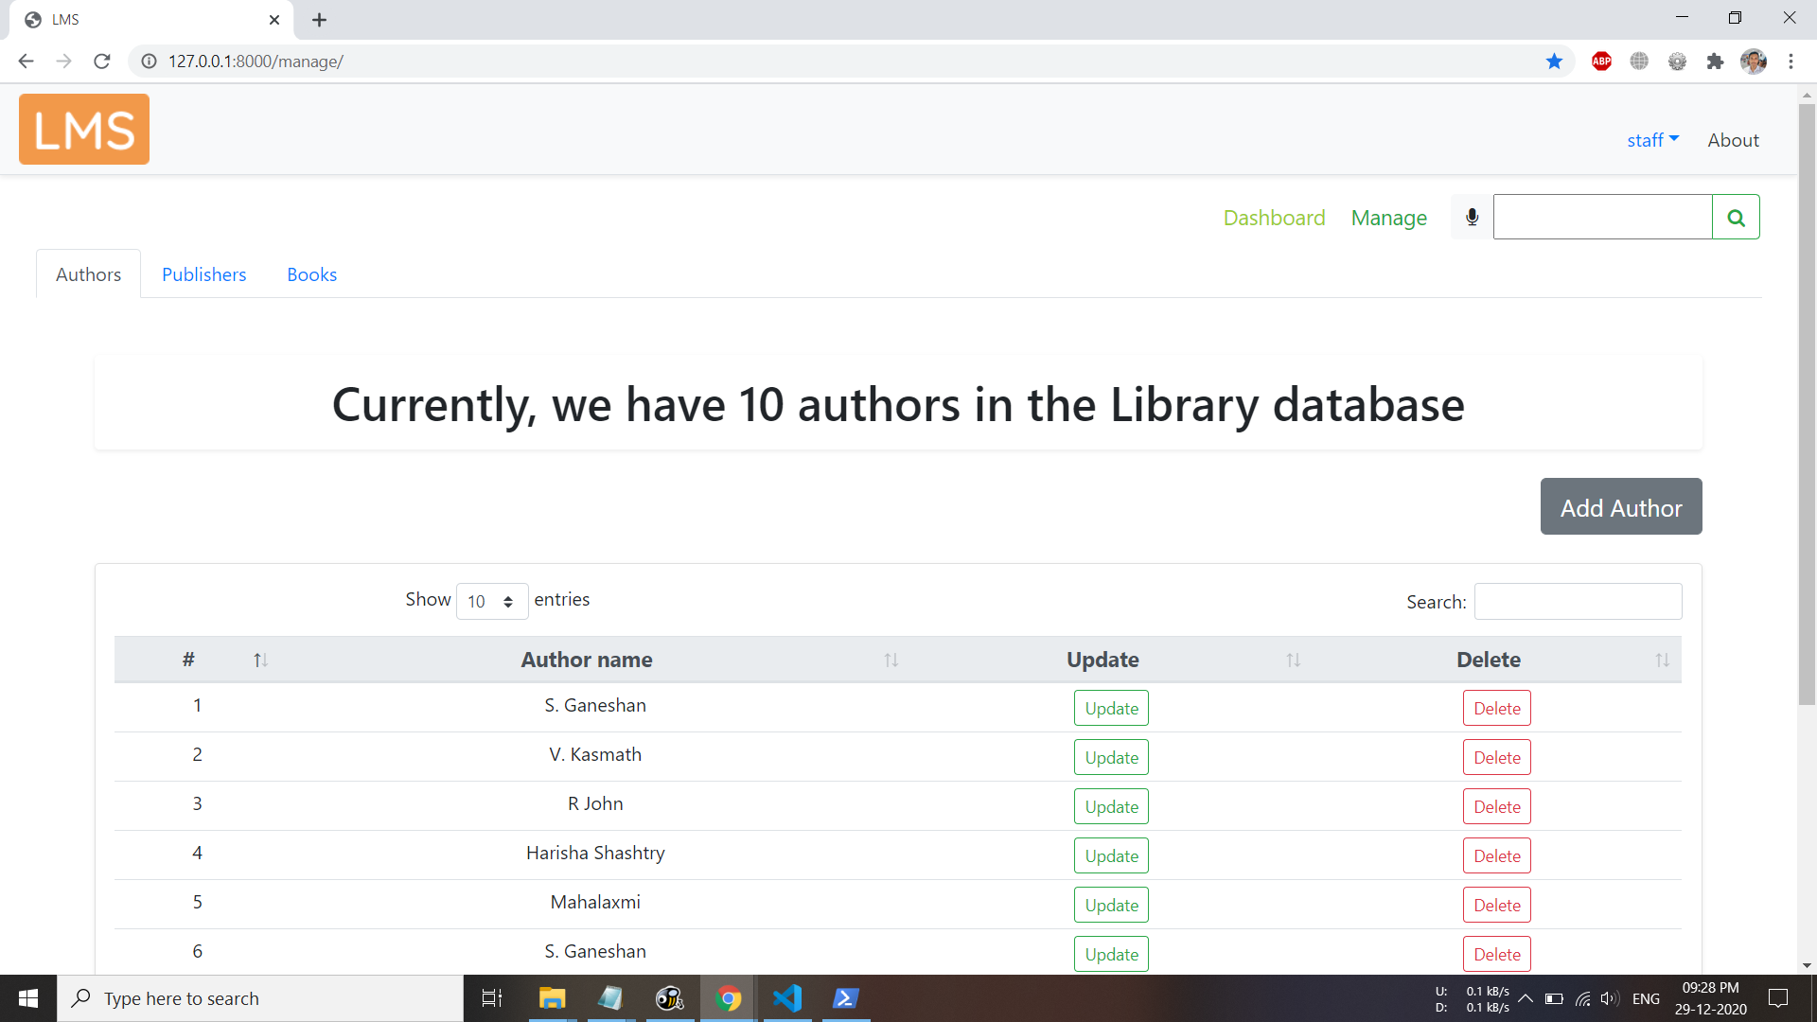
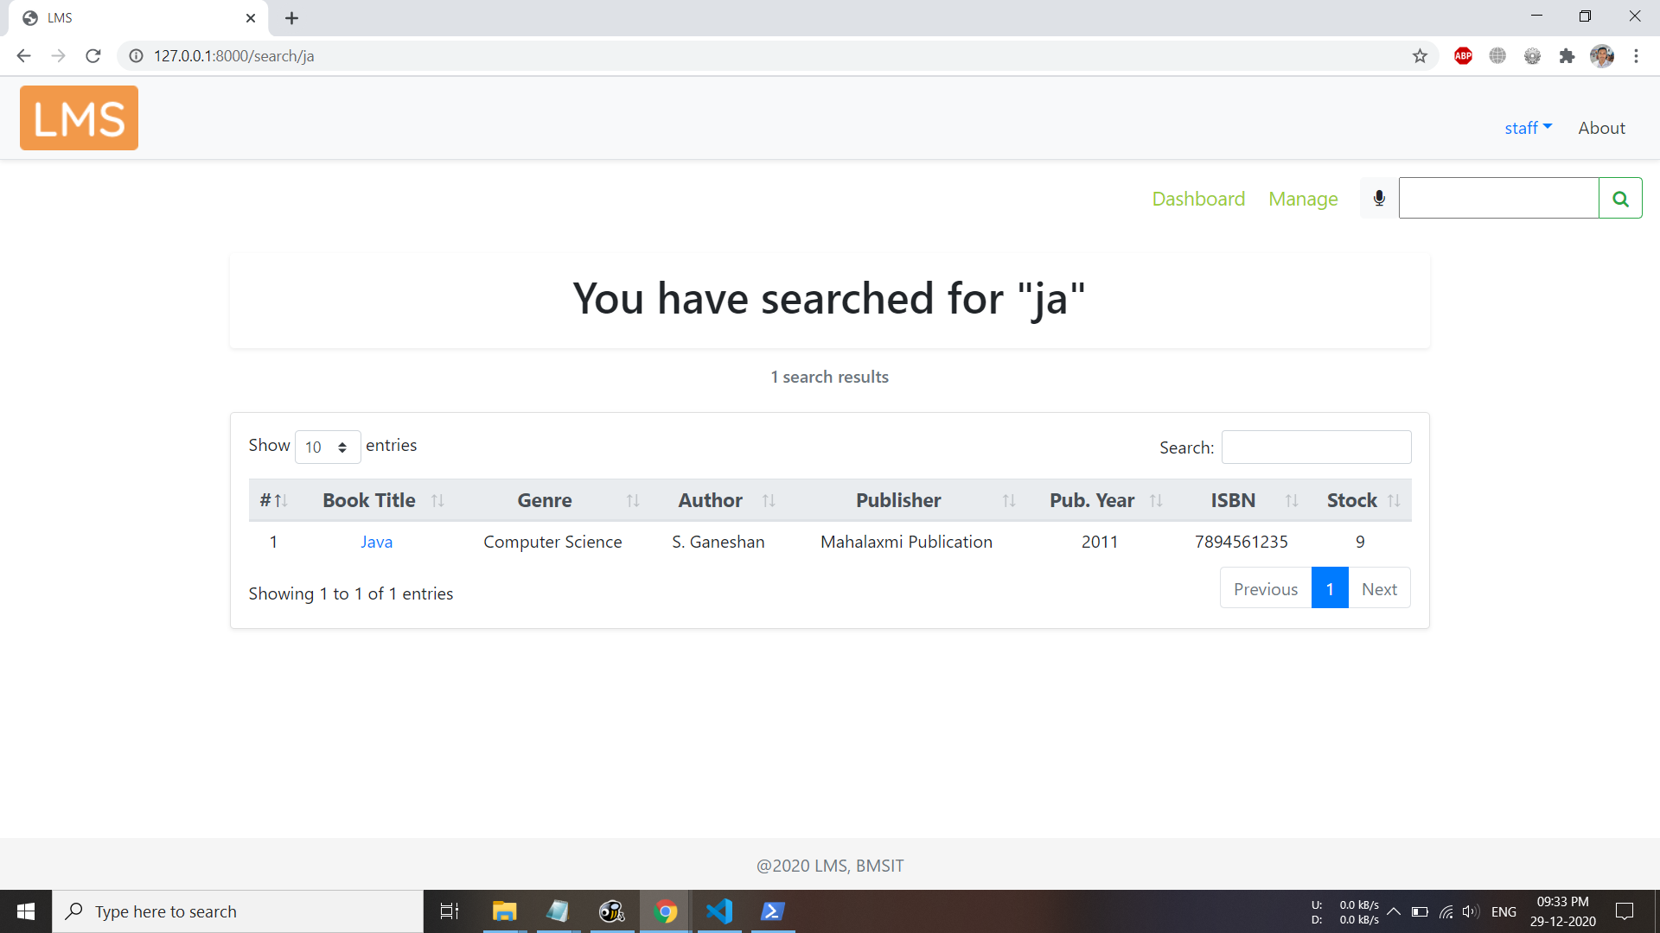
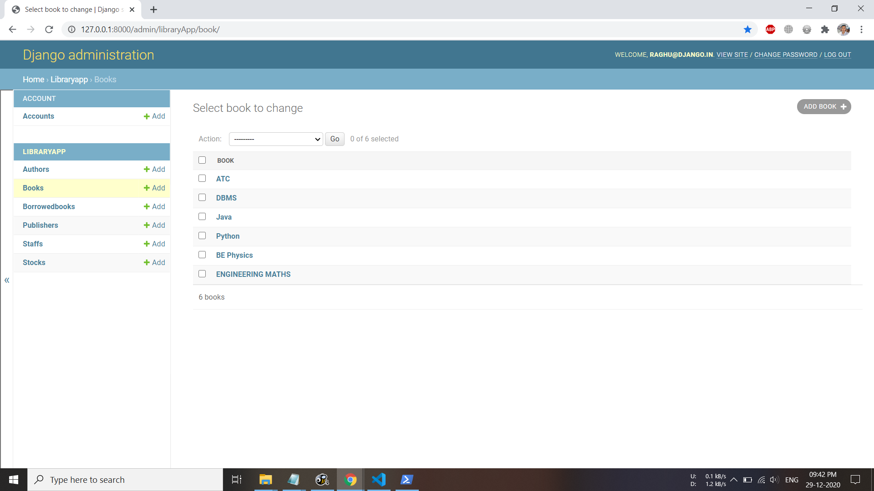
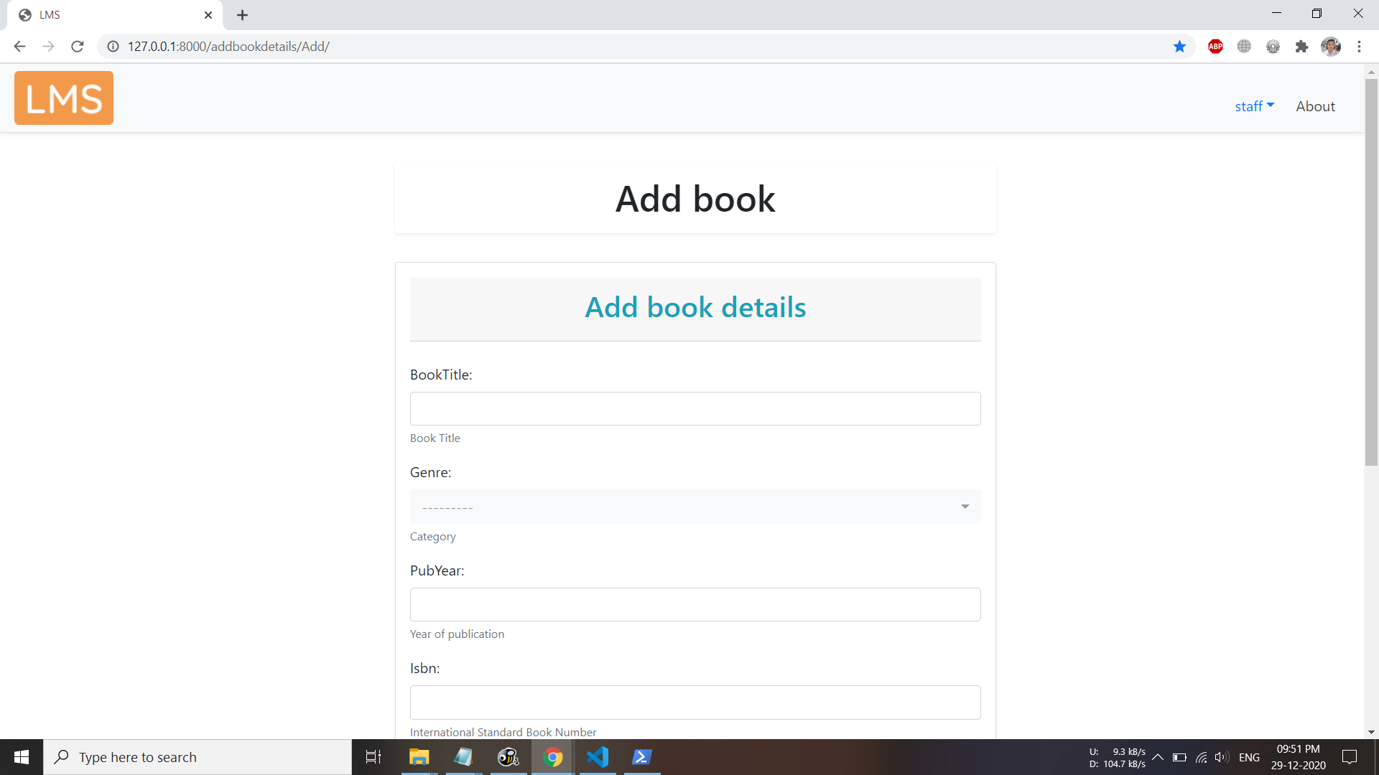

Slide 11
Execution
Click on me!

Slide 12
Conclusion
This Mini Project is for computerizing the working of a library.
This software takes care of all the requirements of an library.
It is capable to provide easy and effective storage of information related to books and users.
This software is not restricted to a college, it can even provide a solution for online rental of library services.

Slide 13
Thank you

